Slide 1


RASD&DD
Hamza Haddaoui,
Giuseppe Piccirillo,
Alessandro Restifo
27/01/2020

Slide 2
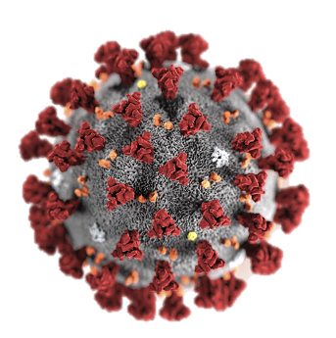

Why?

Slide 3
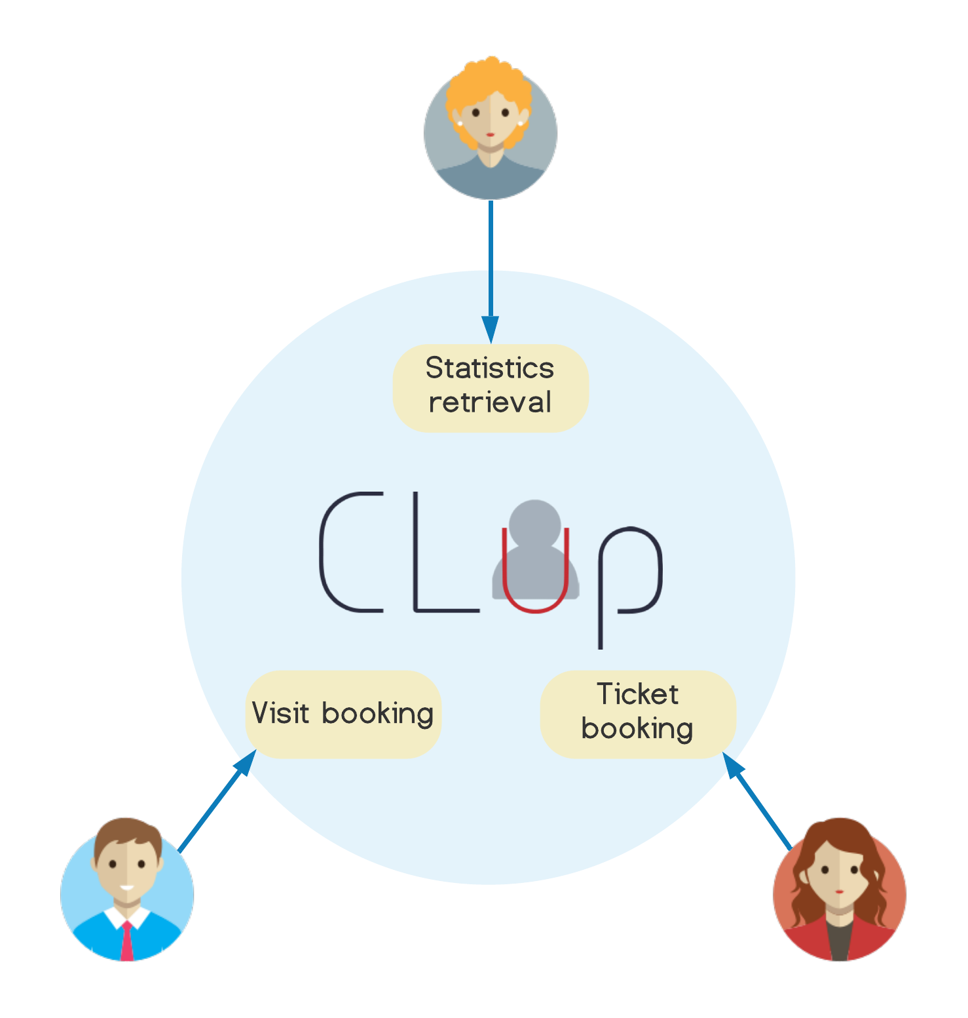
Goals

Slide 4




Domain assumptions

Slide 5
Requirements and
Assumptions
A few requirements to prevent flaws and support development:
[R1] A citizen not yet registered must be able to sign up and become a user
[R6] The application must offer an interface to retrieve issued bookings
[R12] The application must popup suggestion during the booking process
[R14] The system must be able to analyze data and show statistics in order to monitor the entrances
[R15] The system must allow the shop manager to see only data related to her/his store

Slide 6

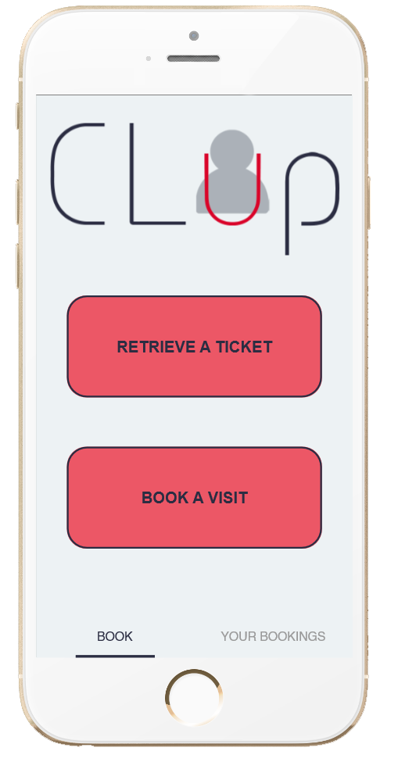
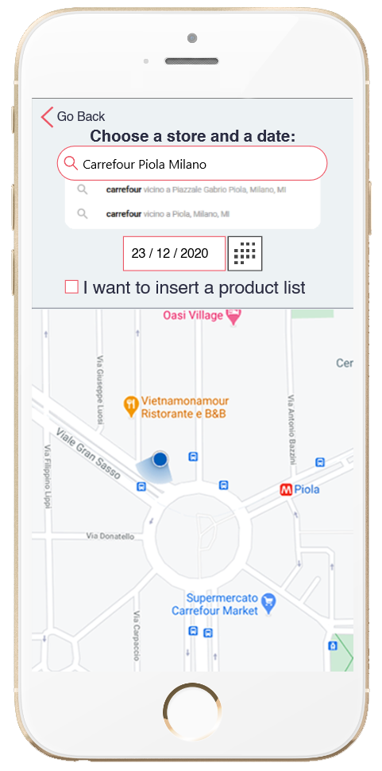
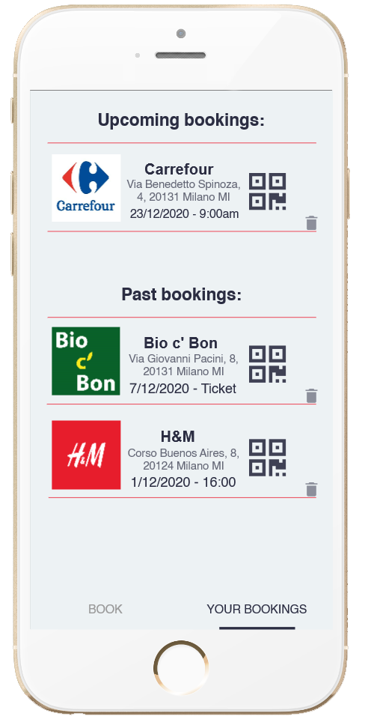
Use case
Visit booking

Slide 7

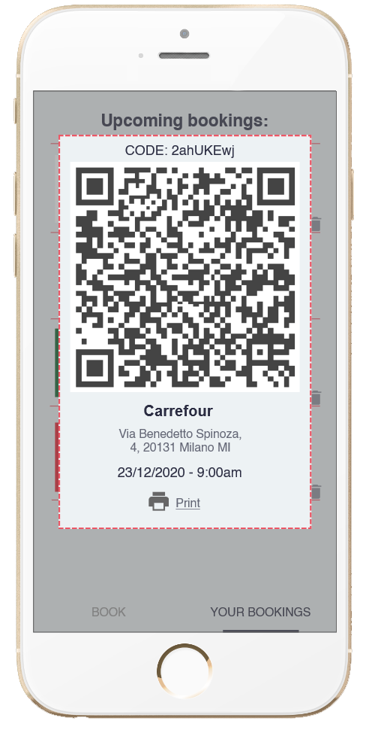
Use case
Visit booking

Slide 8

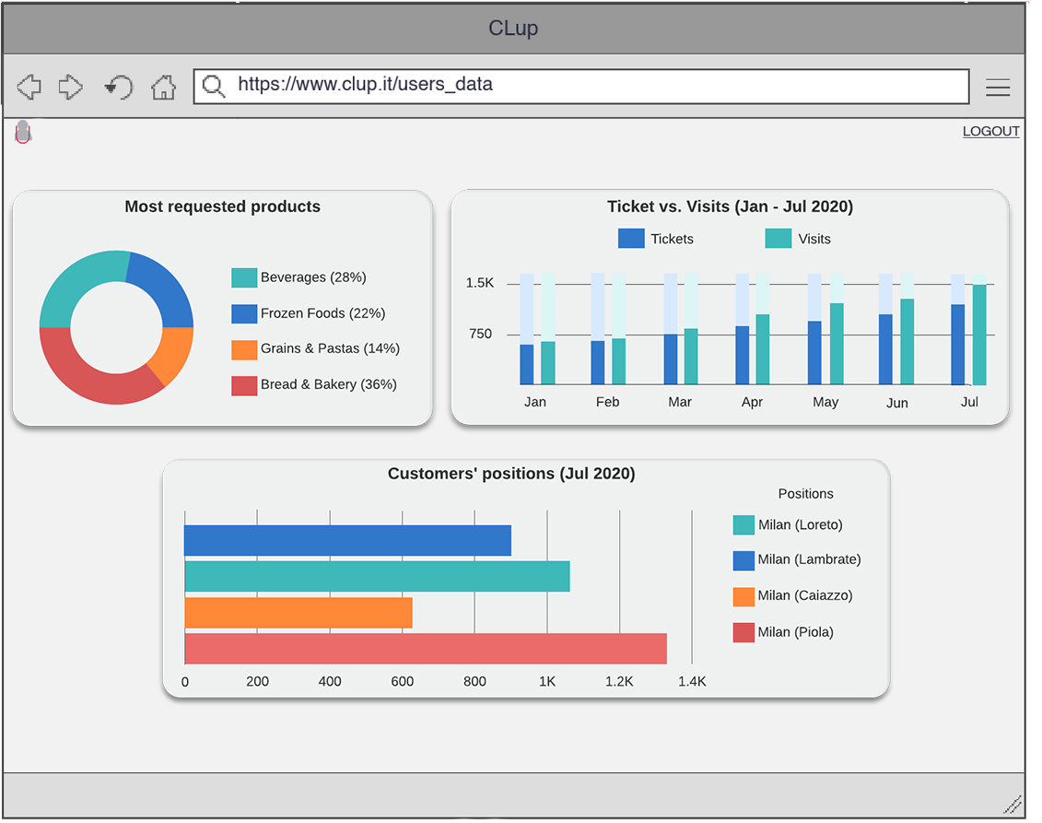
Use case
Shop Management

Slide 9
Model validation
Alloy world

Slide 10
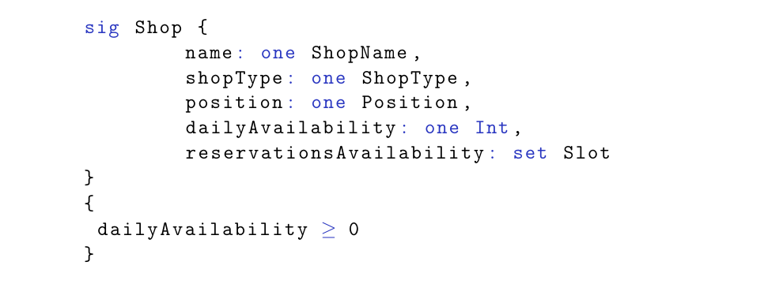
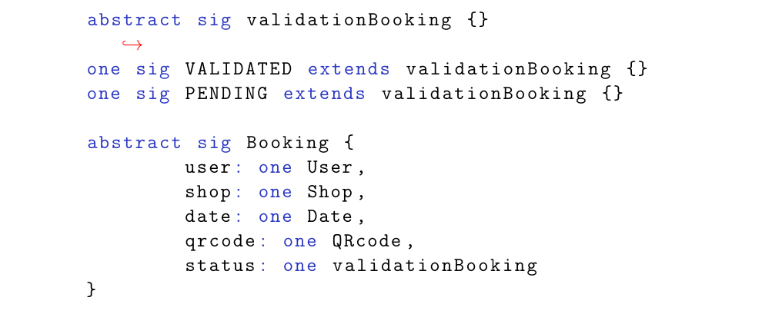
Model validation
Alloy
Objectives:
- Provide clear understanding of the application domain and actors
Through: signatures and relative constraints

Slide 11
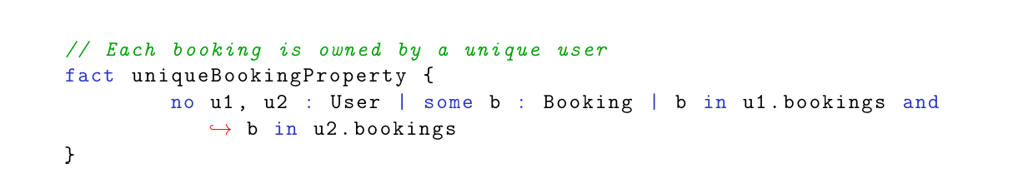
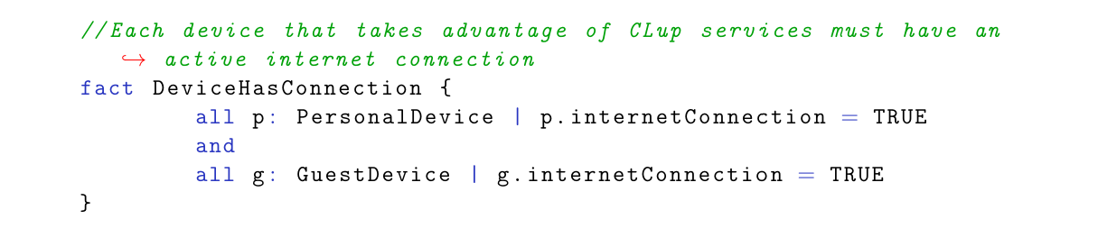
Model validation
Alloy
Objectives:
- Show constraints and requirements
Through: facts

Slide 12
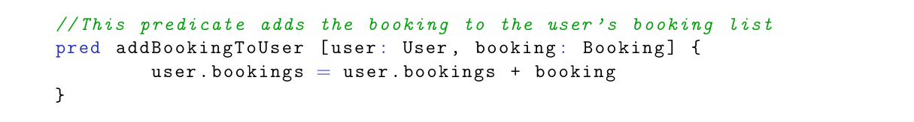
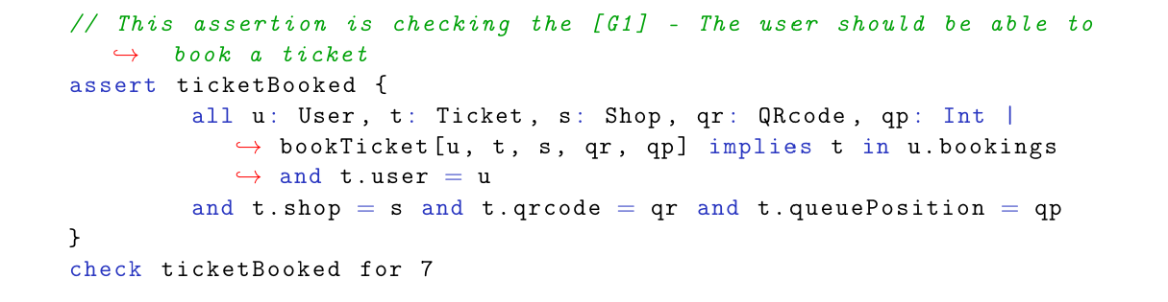
Model validation
Alloy
Objectives:
- Check goals and high-level properties
Through: predicates and assertions

Slide 13
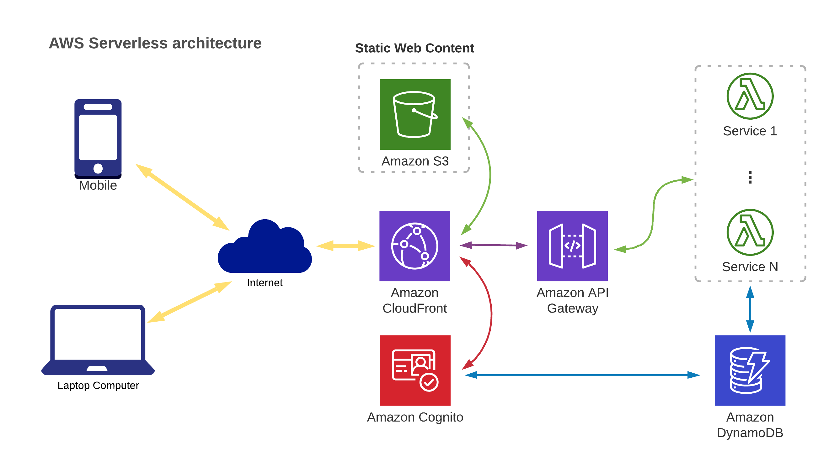
Design ARCHITECTURE

Slide 14
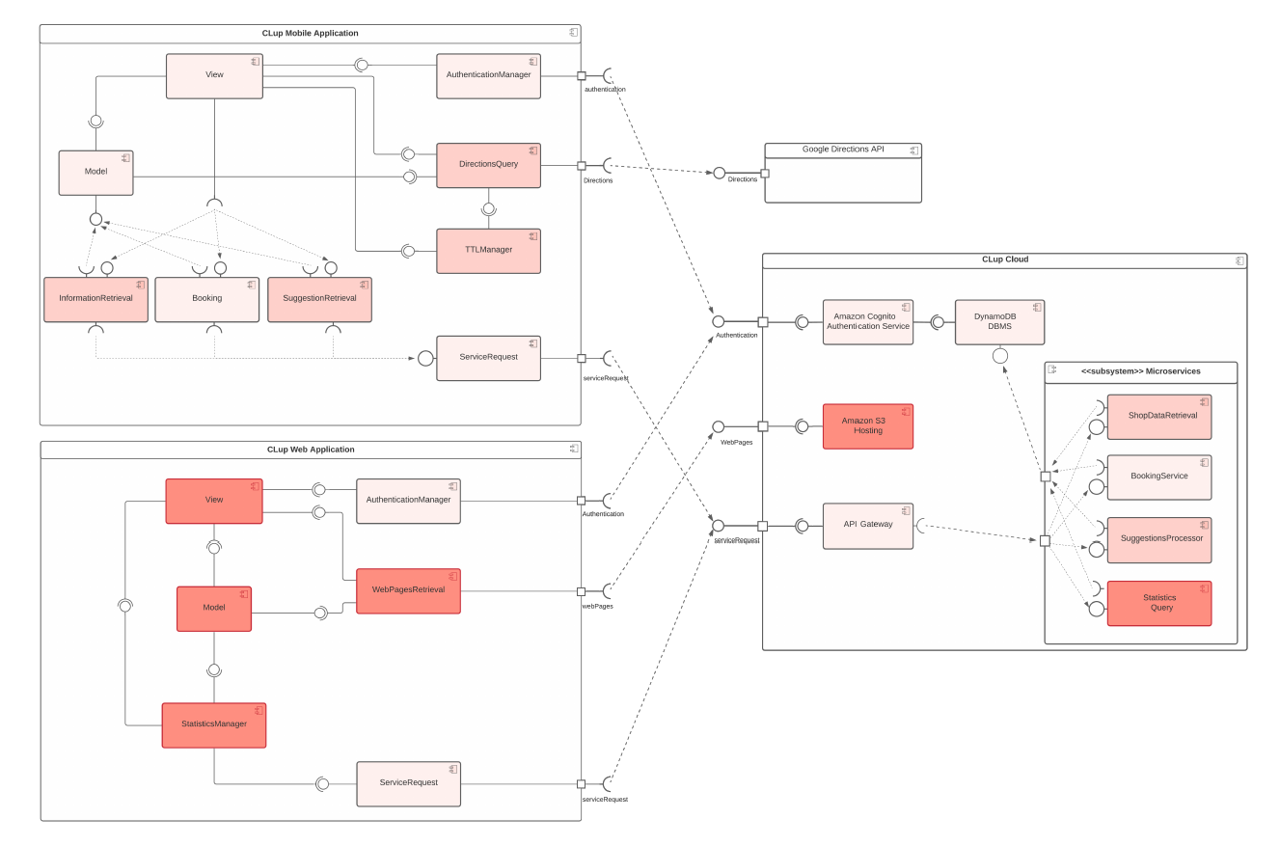
Design IMPLEMENTATION
Approach:
- Bottom-up
Strategy:
- Parallelize development of components relative to same functionality
- Serialize development of different functionalities: more efficient integration testing

Slide 15
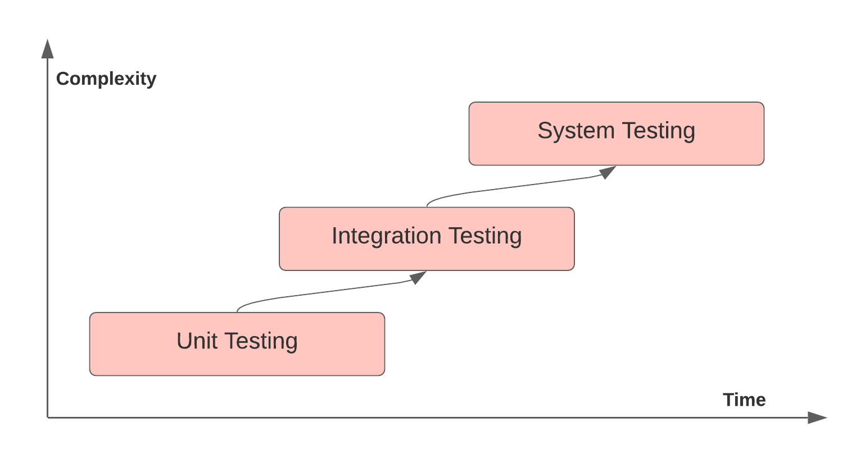
Design TESTING
Approach:
- Unit
- Integration
- System

